Slide 1
DmpRootIOSvc and Data Buffer
Chi WANG

Slide 2
Contents
Why we need it?
  IO
  Data change between algorithms
Implementation
  DmpRootIOSvc
  Time sequence
    DmpVAlg
    DmpCore
    DmpVSvc
How to use it?
  In job option file
  In concrete algorithm
Example

Slide 3
Why we need it
One Job( an object of class DmpCore)
AlgMgr(Algorithm Manager)
SvcMgr(Service Manager)
Algorithm_0
Algorithm_0
Algorithm_0
IO service
Algorithm_0
Algorithm_0
Service_0
Event class: DmpEvt_Alg0_Input
DmpEvt_Alg0_Output
Input root file
Output root file

Slide 4
Why we need it
One Job(an object of class DmpCore)
Another Job(an other object of DmpCore)
Algorithm_0
IOSvc
Algorithm_1
IOSvc
same
DmpEvt_Alg0_Input
DmpEvt_Alg0_Output
DmpEvt_Alg1_Input
DmpEvt_Alg1_Output
Input root file
Output root file
Output root file_2

Slide 5
Why we need it
One Job
Another Job
Algorithm_0
IOSvc
Algorithm_1
IOSvc
same
DmpEvt_Alg0_Input
DmpEvt_Alg0_Output
DmpEvt_Alg1_Input
DmpEvt_Alg1_Output
Input root file
Output root file
Output root file_2
Feature: Data communication,
How to combine 2(more) algorithms in one job?

Slide 6
We need RootIOSvc and Data buffer
One Job
RootIOSvc
NOTE:
DmpEvt_Alg1_Input == DmpEvt_Alg0_Output
Data Buffer
Algorithm_0
Algorithm_1
DmpEvt_Alg0_Input
DmpEvt_Alg1_Input
DmpEvt_Alg0_Output
DmpEvt_Alg1_Output
Read only
Input root file
Output root file
Read and Write
可在Job option中选择性写出一个或多个Algorithm 的output数据

Slide 7
DmpRootIOSvc: for job option
User Interface(setting option):
void Set(string option, string argv)
option and argv
  Option = InData/Read
    argv = any root file (extension must == “.root”)
  InData/Update
    argv = any root file (extension must == “.root”)
    write new data into input root file
  OutData/FileName
    argv = any string
    If NOT set, will write nothing
  OutData/Write
    Important
    If NOT set, will write nothing

Slide 8
DmpRootIOSvc: for concrete alg.
User Interface (Read or Register data):
TObject* ReadObject(string path)
  // Read data from data buffer
template<typename T>
bool RegisterObject(string path,
string className, // name of event class
T *&dataPtr)
  // register event class into data buffer. Book branch automatically
template<typename T>
bool RegisterObject(string path,
T *&dataPtr)
  // register TClonesArray into data buffer, Book branch automatically

Slide 9
Time sequence
Job option
DmpCore
RootIOSvc
Algorithms
Initialize
Initialize
RegisterObject
Initialize
(create object of output data)
ReadObject
ProcessThisEvent
Run(loop)
ProcessThisEvent
If all alg. succeed
FillEvent
Finalize
Finalize
Finalize

Slide 10
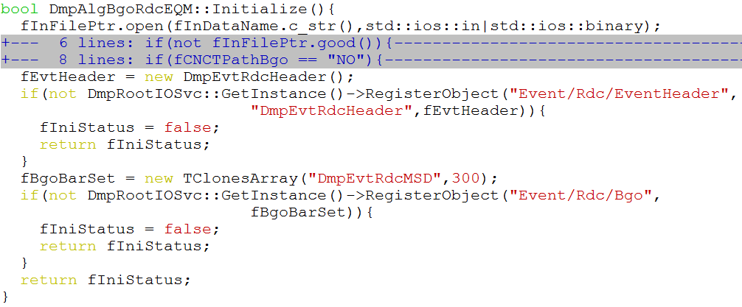
How to use it?
RawDataConversion/Bgo/BgoRdcEQM

Slide 11
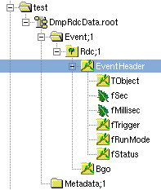
Out file structure

Slide 12
Conclusion
Provide IO service for root files, DmpRootIOSvc
Provide Data buffer
  Data communicate between algorithms

