Slide 1
Some Test Results of Raw Data
Dong Jianing, Liu Dong

Slide 2
A2Data00_20140513-155749.frd
Wang chi:
Error: Last Event cannot be read normally

Slide 3
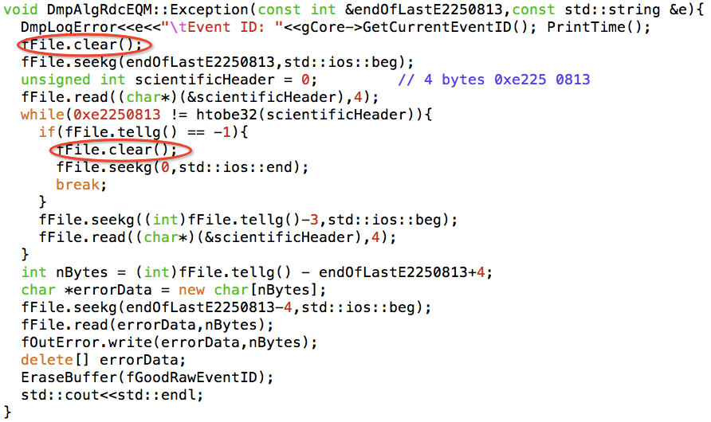
A2Data00_20140513-155749.frd
Solution: Add a function - ios::clear()

Slide 4
A2Data00_20140513-164225.frd
Wang chi:
Error: Data Mode cannot be processed correctly

Slide 5
A2Data00_20140513-164225.frd
Solution: Modify the way to process the data mode

Slide 6
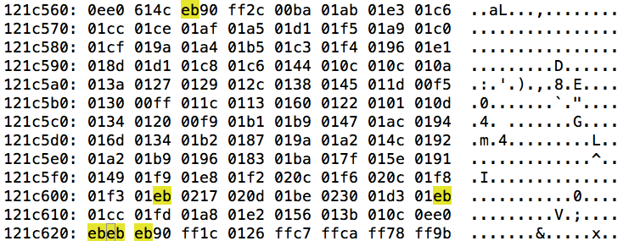
A2Data00_20140513-155749.frd
Zhiyong:
Error: Data header cannot be read normally

Slide 7
A2Data00_20140513-174024.frd
? Solution:
1. 使用分包的数据
2. 修改代码使其能够正确读取BGO以外的数 据

