Slide 1
DAMPE software introduction
Dong Liu, Chi Wang
University of Science and Technology of China
2014-12-5, Nanjing

Slide 2
Outline
Overview
Driving mechanism
Event class
Algorithm
Show how to write event class and algorithm

Slide 3
Overview

Slide 4
Overview
Purpose
  Provide a platform
  Provide a driving mechanism
Environment
  Linux, boost, python, scons
  Boost: provide some function,
  provide an interface between python and c
  Python: provide convenient script
  Scons: provide a compilation tool
Contents

Slide 5
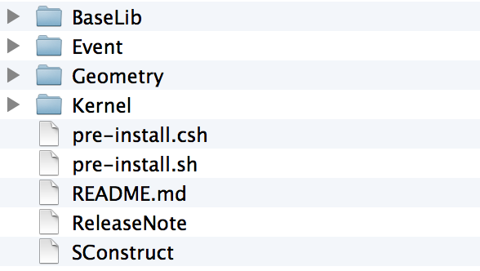
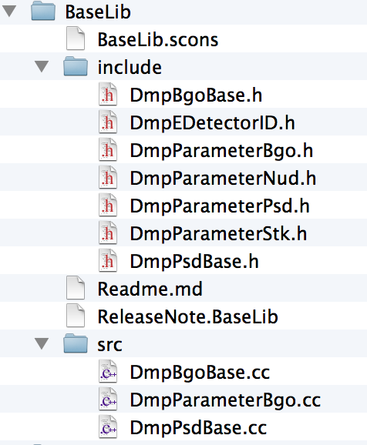
Overview
Contents
Give an ID to every part of the detector,
barID, PMTID, layerID …
Give parameters for the detector
planeNo, LayerNo, …,BarCenter, LayerCenter

Slide 6
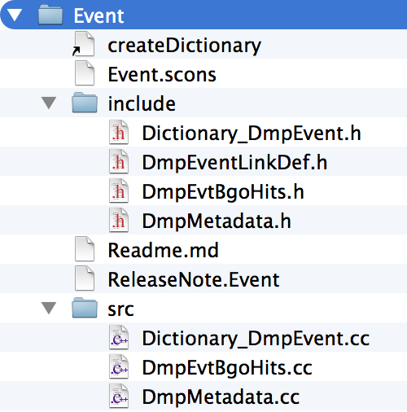
Overview
Contents
Global event: BgoHit, Metadata

Slide 7
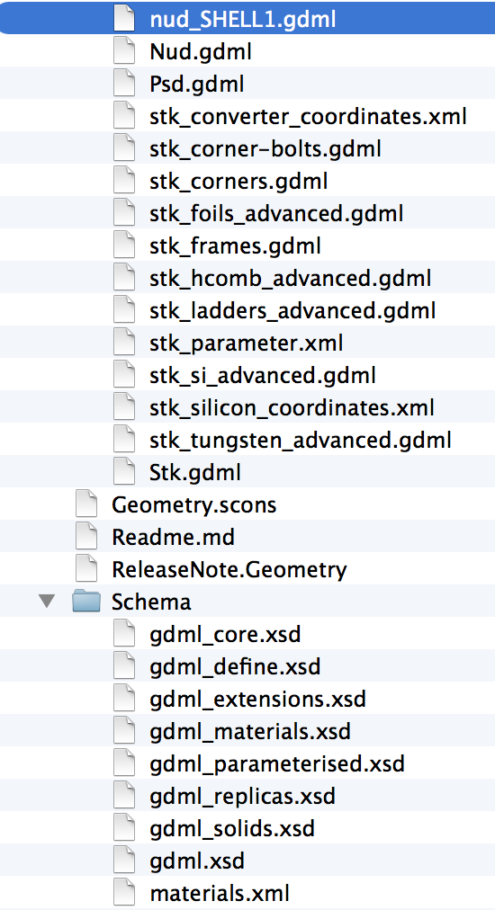
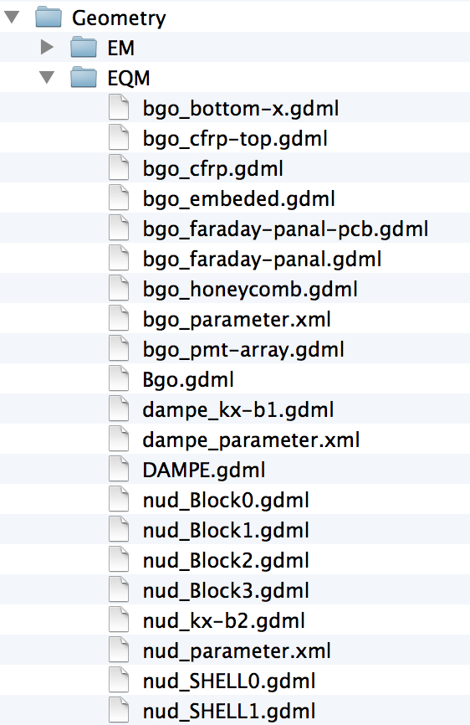
Overview
Contents
Geometry of the detector

Slide 8
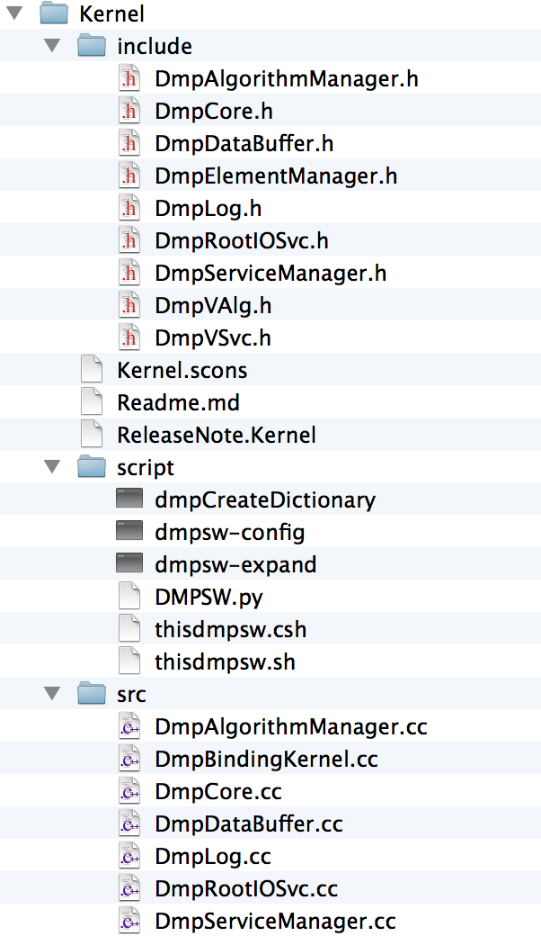
Overview
Contents
Kernel of the software, manager the whole job.
Script: provide some executable command,
dmpCreateDictionary: provided for event class
dmpsw-config: provided for getting configure info
Dmpsw-expand: provided for expanding user
algorithm, service and event class

Slide 9
Overview
Contents
Kernel of the software, manager the whole job.
include and src will be used to construct kernel lib

Slide 10
Driving mechanism

Slide 11
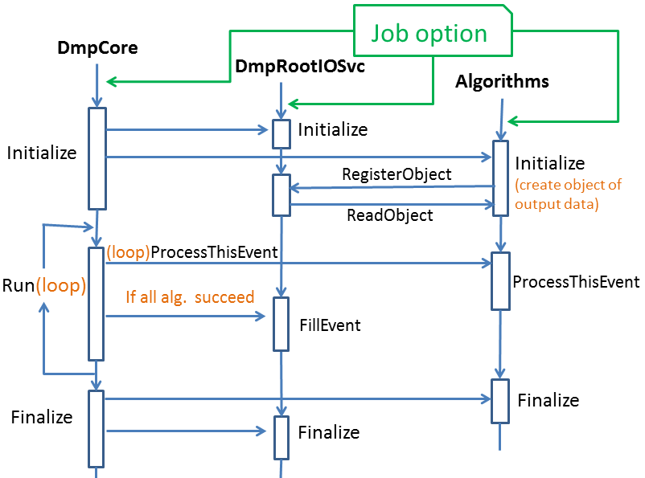
Driving mechanism

Slide 12
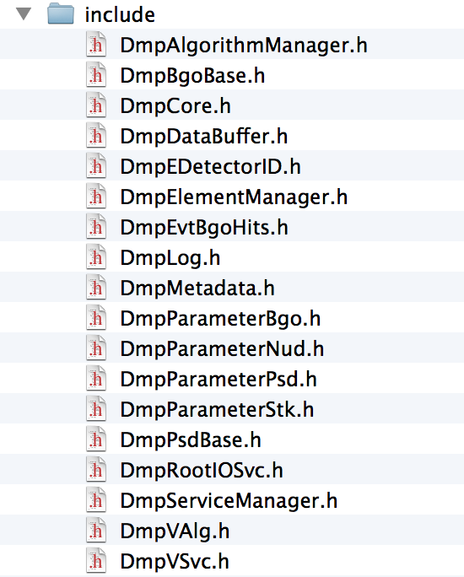
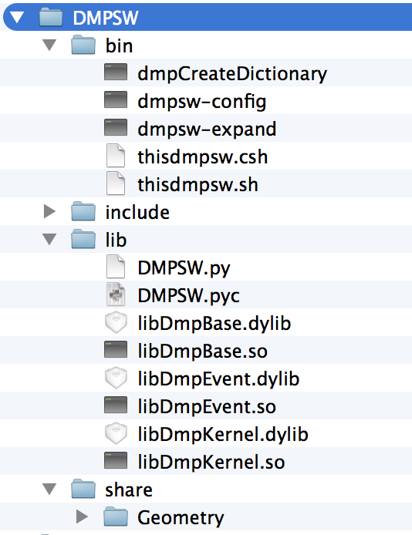
Driving mechanism
After installation

Slide 13
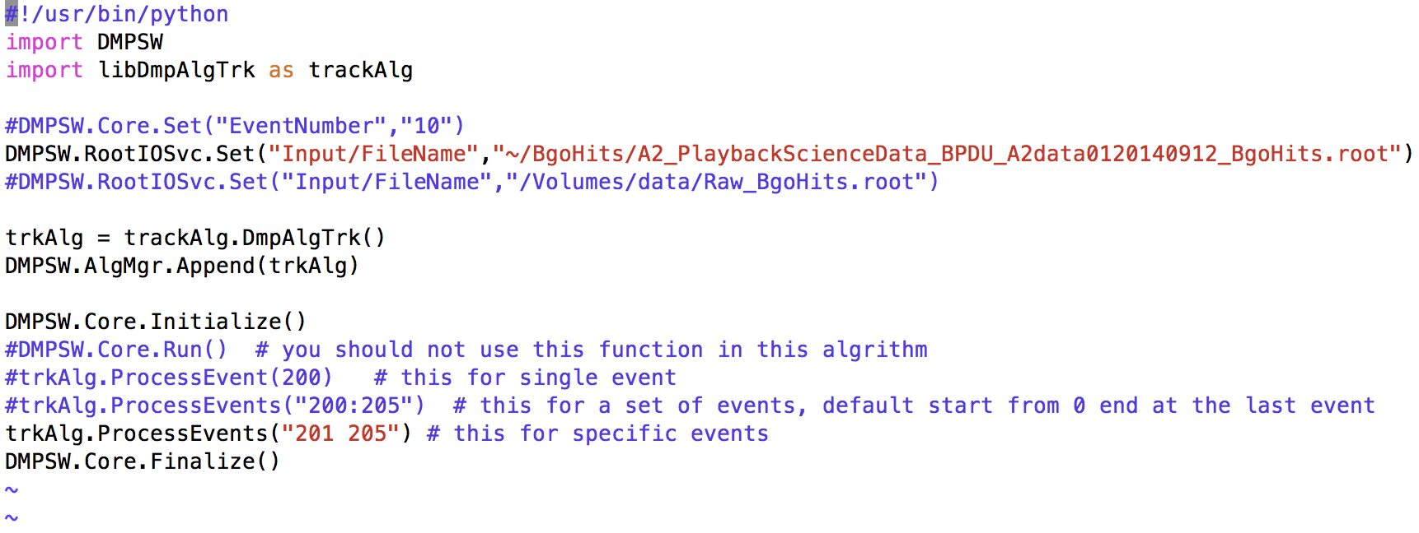
Driving mechanism
JobOption
Import the kernel of the software
Import user module
Set options, include Core, Services, Algorithm
Create an object of user defined algorithm
Let core run the job

Slide 14
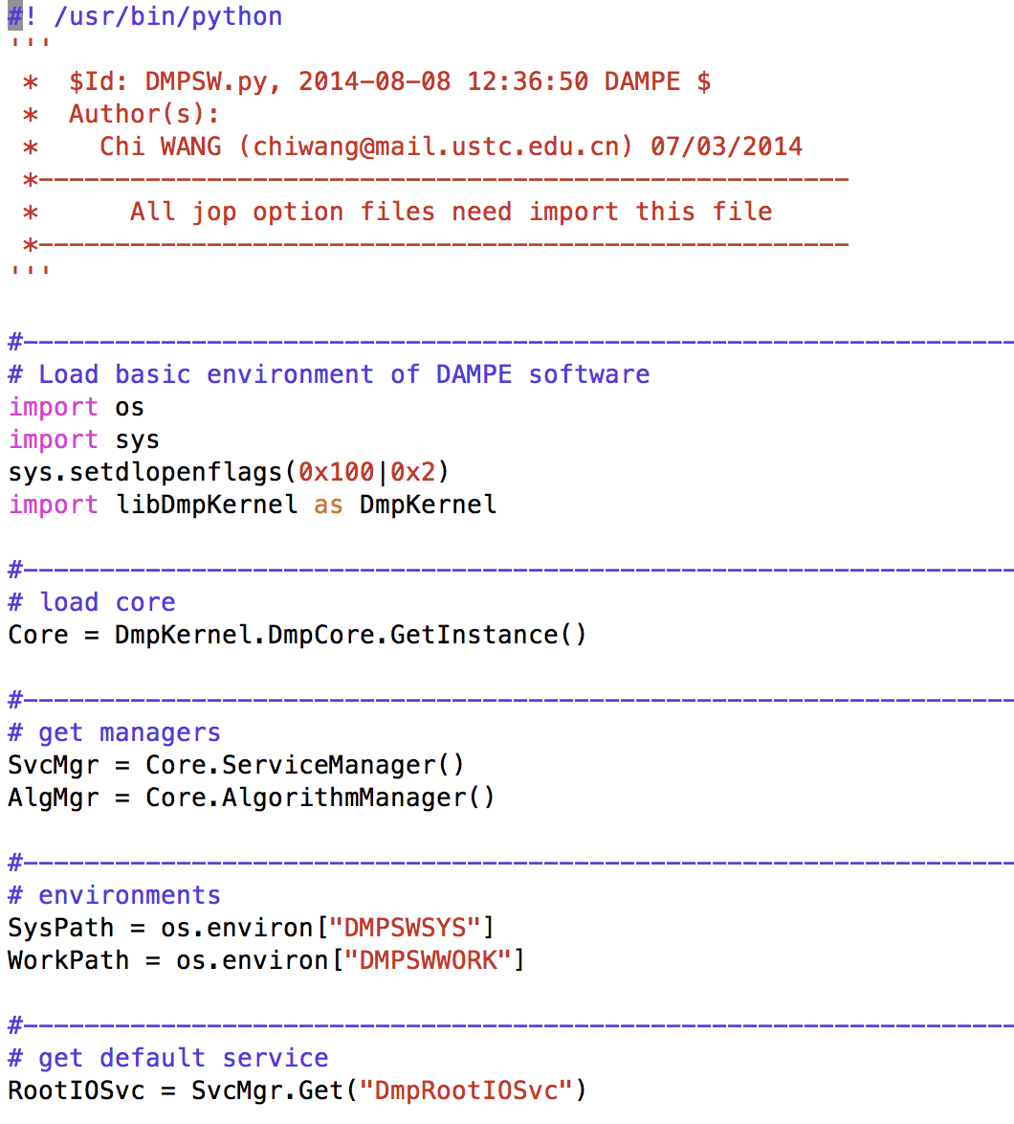
Driving mechanism
DMPSW.py

Slide 15
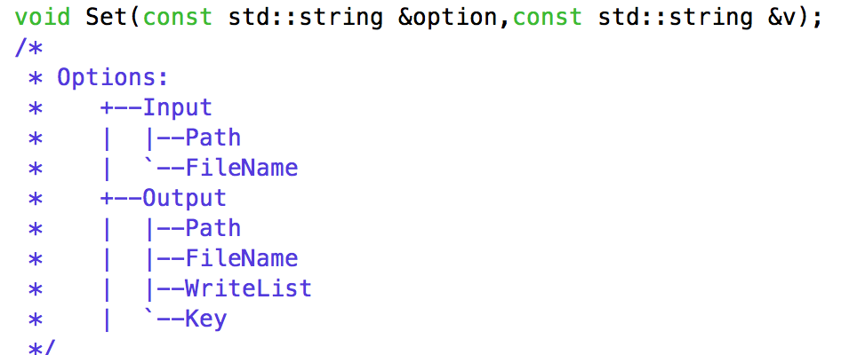
Driving mechanism
RootIOScv.Set()
gRootIOSvc->Set(“Input/Path”,”.”)

Slide 16
Driving mechanism
Core.Set()

Slide 17
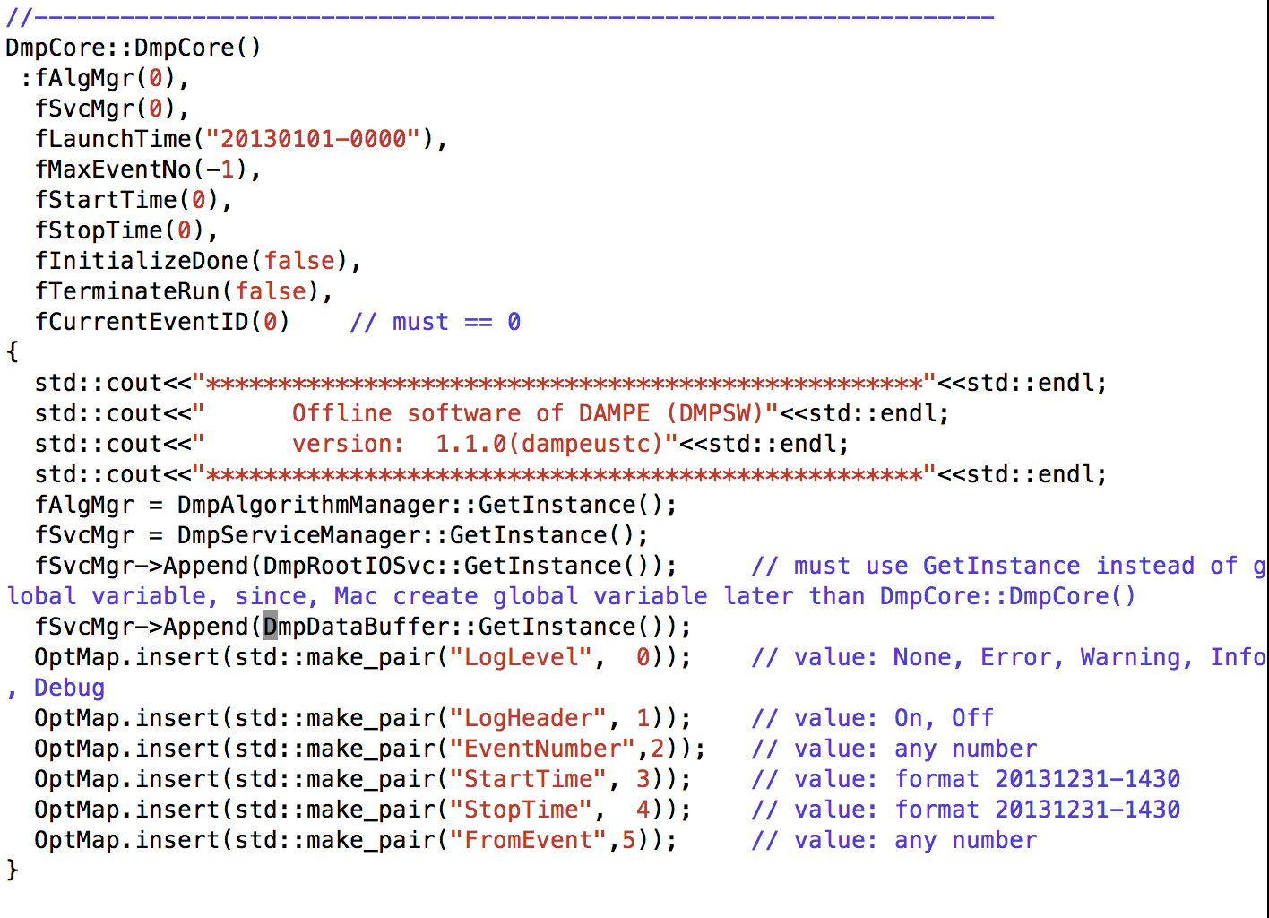
Driving mechanism
Core.set()

Slide 18
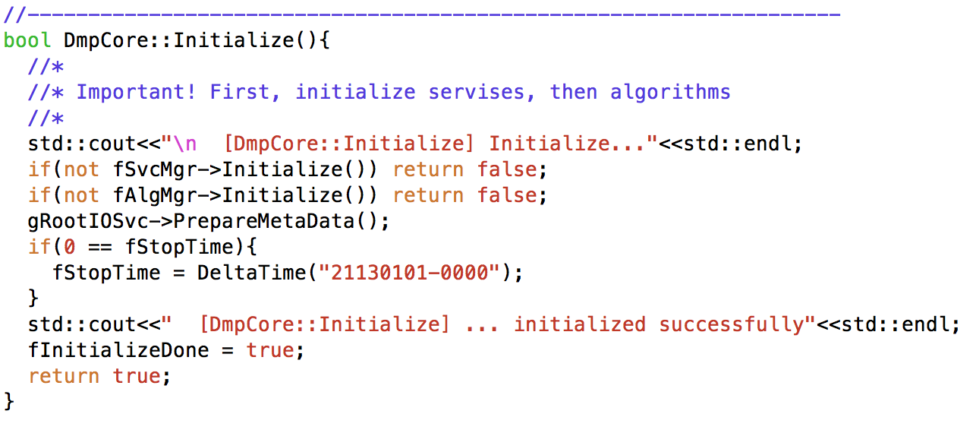
Driving mechanism
DmpCore manage the whole job. All jobs start from it and end with it.

Slide 19
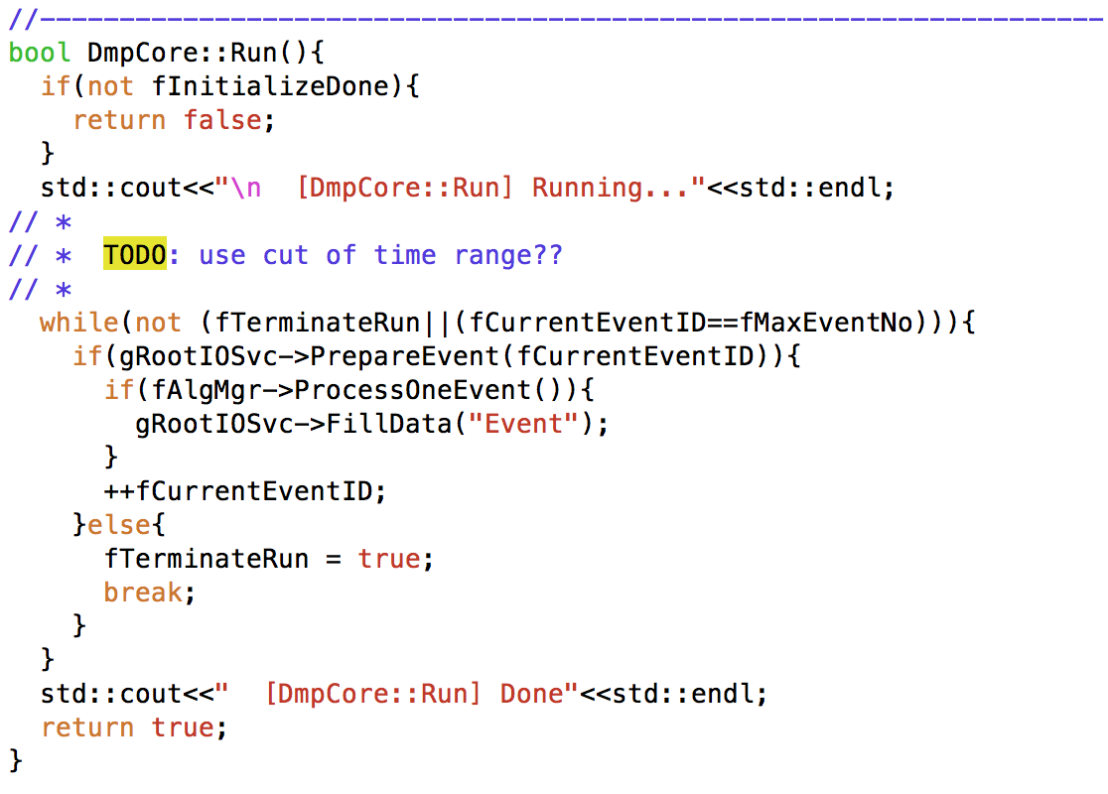
Driving mechanism
DmpCore manage the whole job. All jobs start from it and end with it.

Slide 20
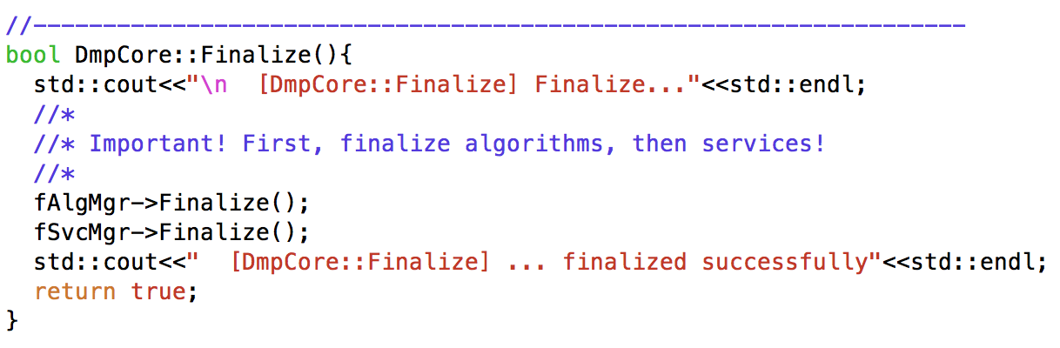
Driving mechanism
DmpCore manage the whole job. All jobs start from it and end with it.

Slide 21
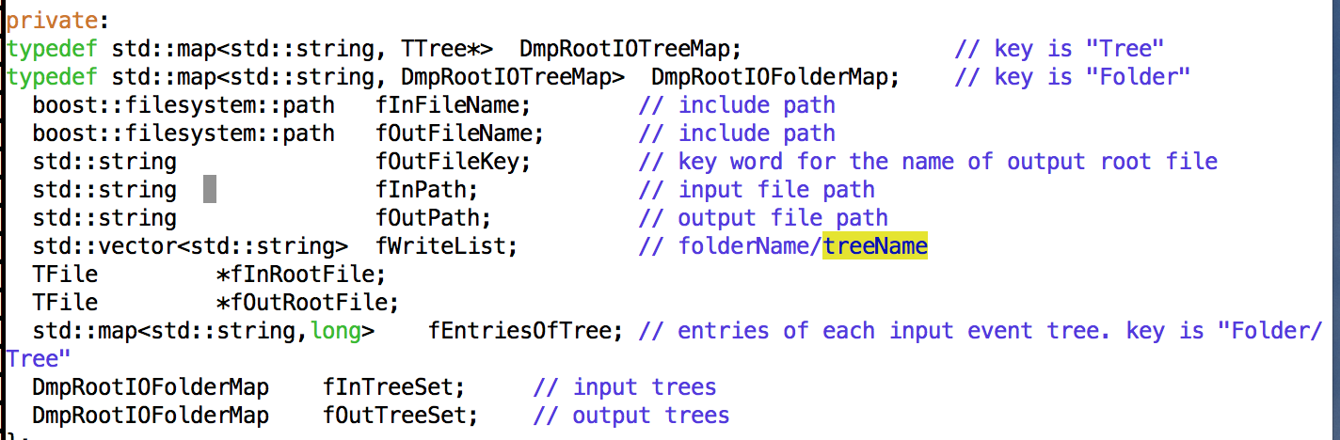
Driving mechanism
RootIOSvc
  Provide interface for input and output data, only one input root file and one output root file.

Slide 22
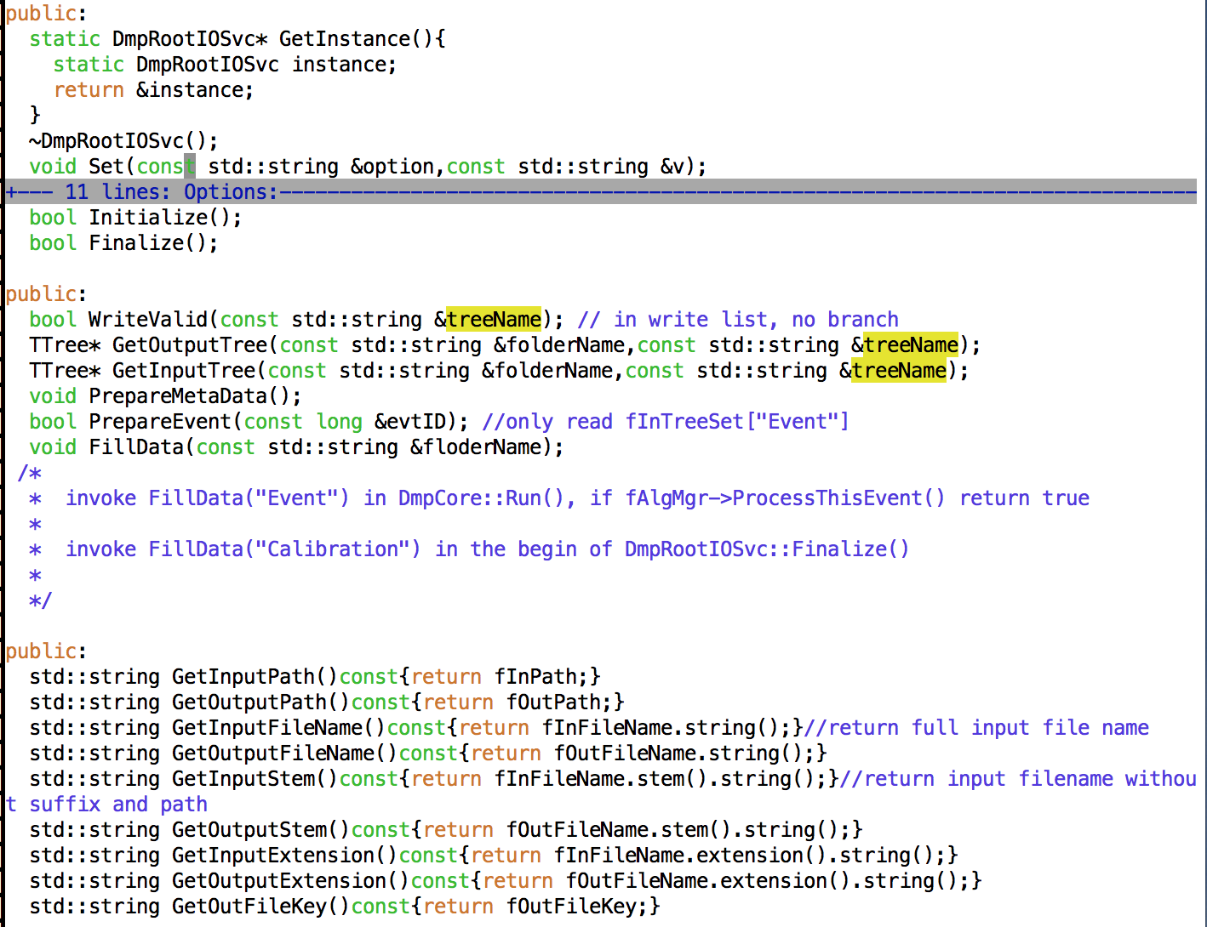

Slide 23
Driving mechanism
DataBufferSvc
  Provide interface for data exchange input between algorithms
  Two useful function
    LinkRootFile(PathString , EventClassPointer)
    RegisterObject(PathString, EventClassPointer, ClassName)

Slide 24
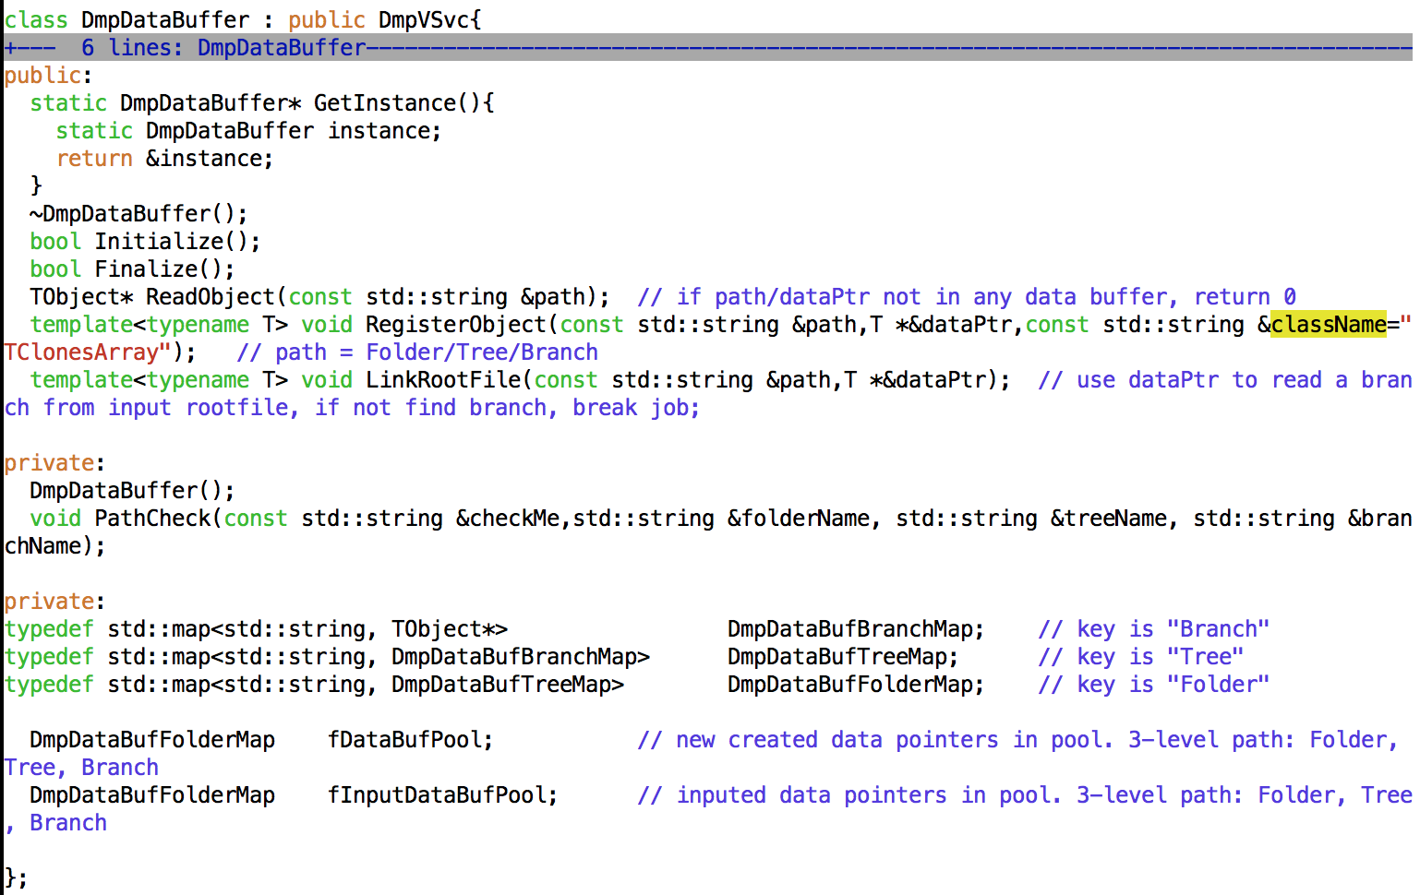

Slide 25
Event class

Slide 26
Event class
Why event class
From procedure of data analysis in high energy physics, the core is the extraction, analysis and encapsulation of event information. It’s important to define the data.
For dampe offline software, we define our event class based on TObject of root. Advantages:
  Uniformed data structure, separated data module
  Benefit for data saving
  Benefit for data exchange
  Benefit for maintenance and update

Slide 27
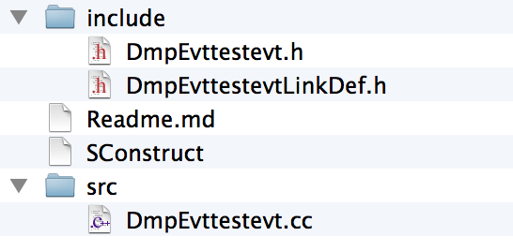
Event class
Create an event class
  dmpsw-expand --evt EventName
  dmpsw-expand --evt testevt
  Sconstruct: file for scons command
  add your own data members and member functions
  dmpCreateDictionary: let ROOT recognize your class member, otherwise the next step will have some error!
  scons: install include file and lib to your work directory
  **LinkDef.h: will be used by dmpCreateDictionay

Slide 28
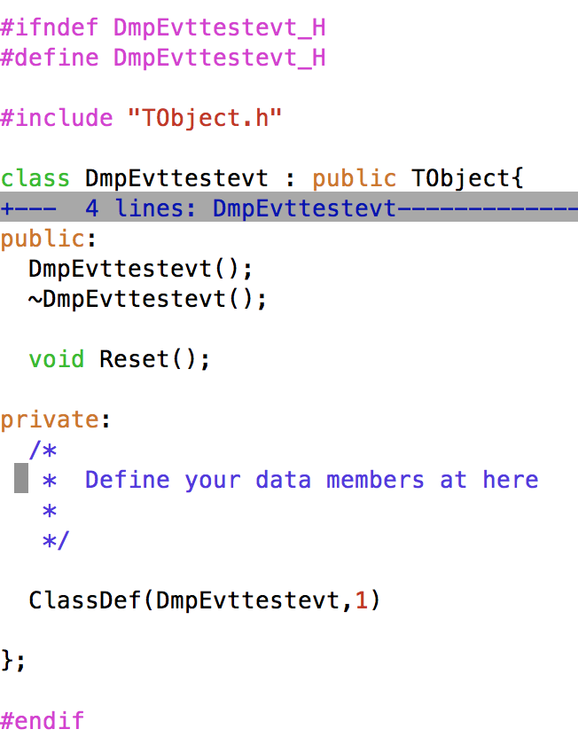
Event class
Evt**.h
You can declare your
member function here.
You can realize these
functions in Evt**.cc file.
You can declare your
member variable here

Slide 29
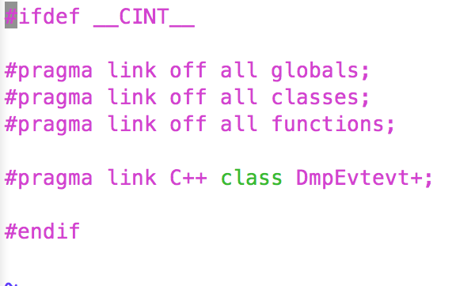
Event Class
LinkDef.h

Slide 30
Event Class
Dictionary file: created by dmpCreateDictionary
  Dictionary**.h
  Dictionary**.cc

Slide 31
Algorithm

Slide 32
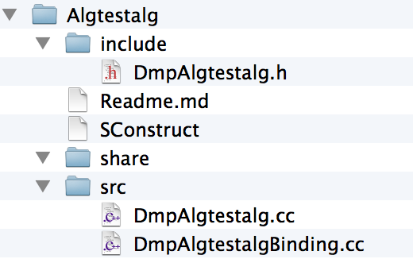
Algorithm
Create an algorithm
  dmpsw-expand –alg AlgorithmName
  dmpsw-expand –alg testalg
  Sconstruct: file for scons command
  realize predefined function in the algorithm
  add your own functions
  scons
  create a jobOption file

Slide 33
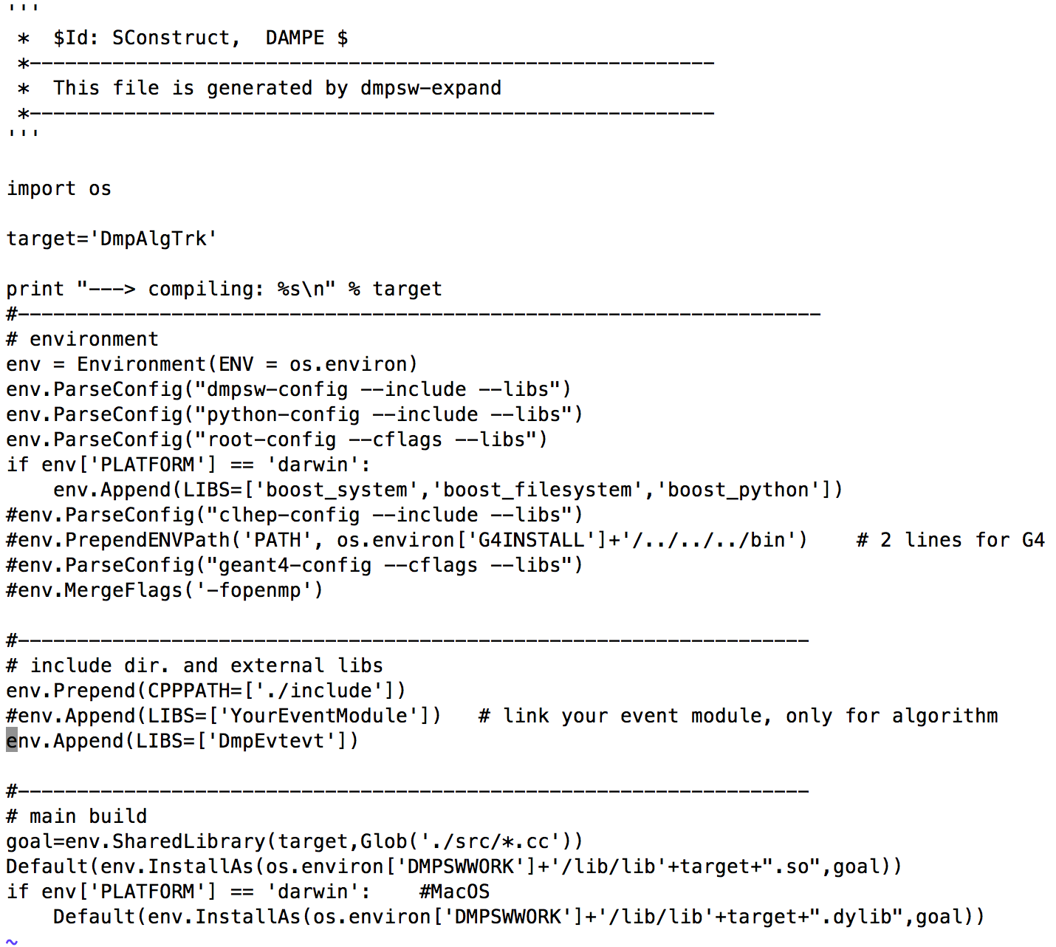
Algorithm
SConstruct
Add my own lib

Slide 34
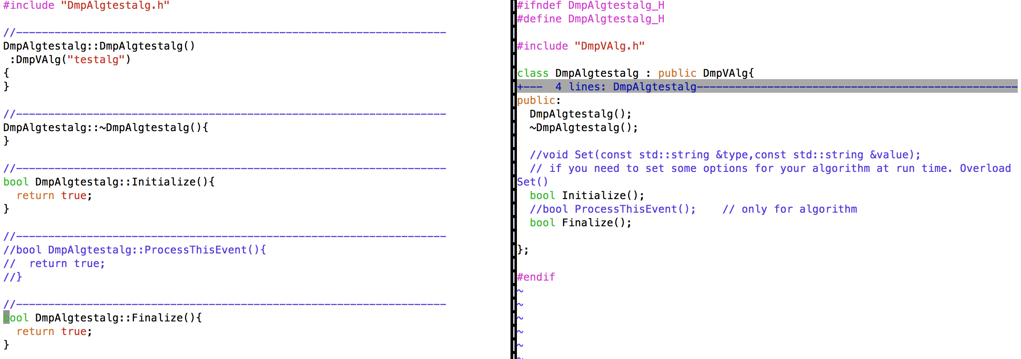
Algorithm
Source file
in algorithm, you should remove annotation symbol before ProcessThisEvent().
Realize Initialize() and Finalize() functions.

Slide 35
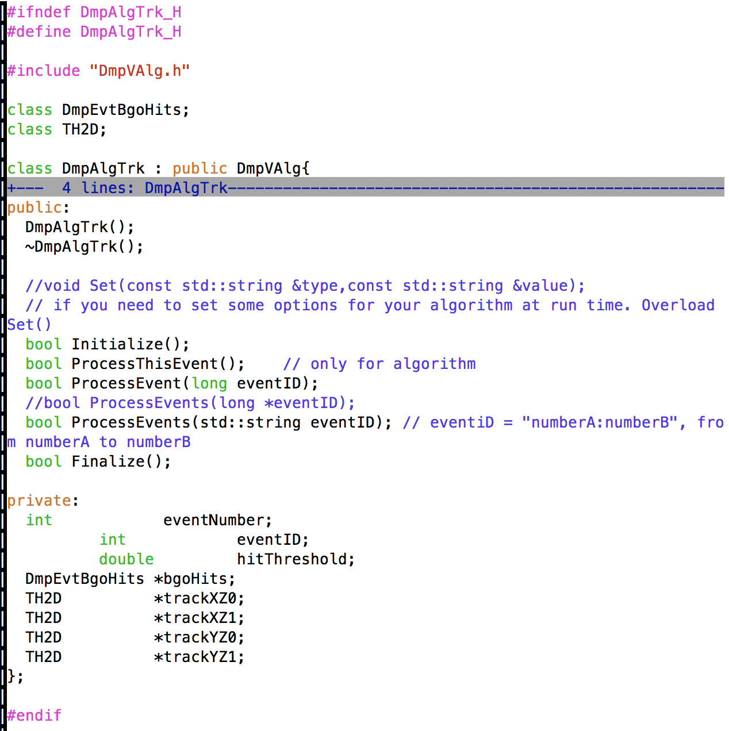
Algorithm
Example: draw track
Head file, declare some functions
and members

Slide 36
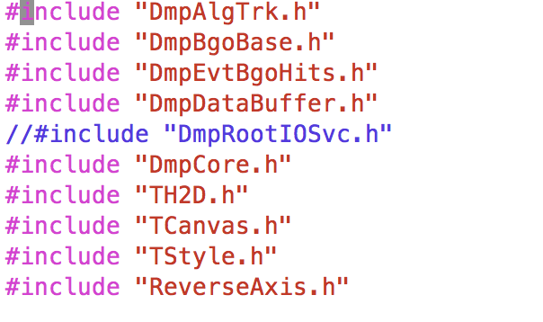
Algorithm
Example: draw track
source file, realize functions
and members that have been declared
Include the classes you will use in you algorithm.
Databuffer has included DmpRootIOSvc.h

Slide 37
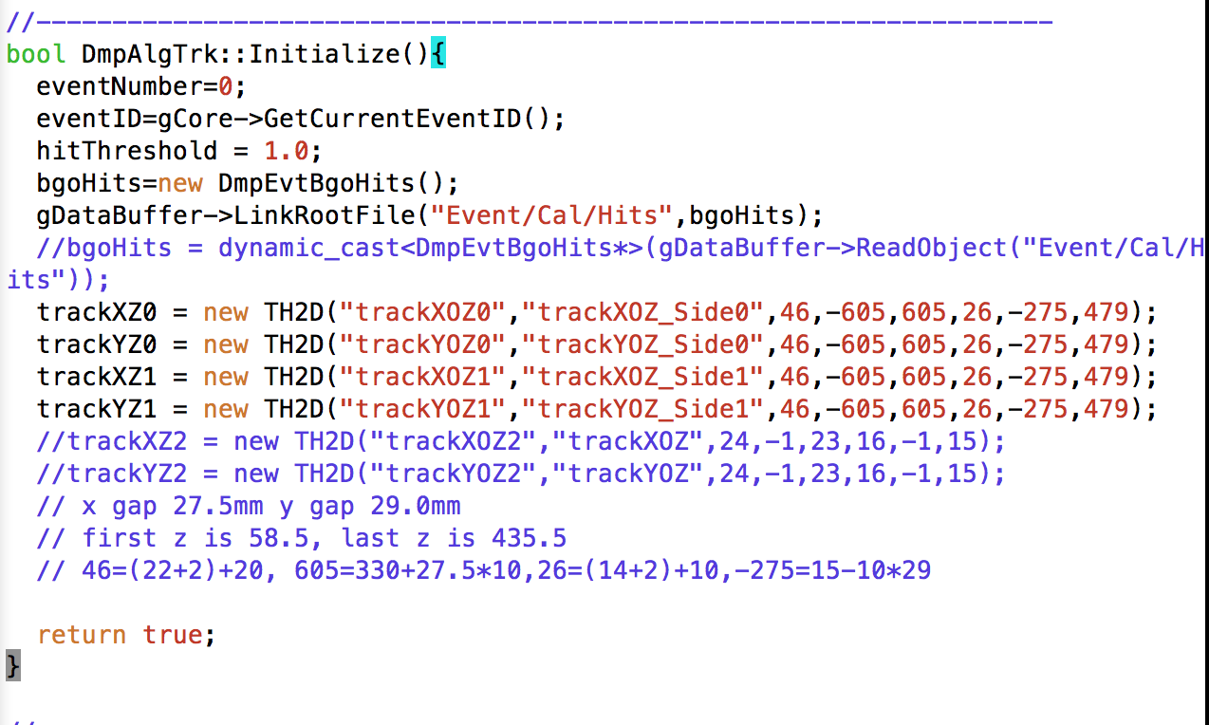
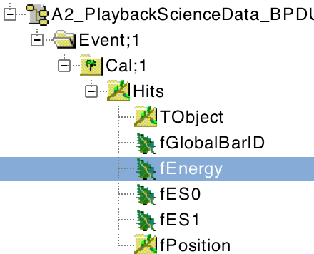
Algorithm
Example: draw track
source file, realize functions
and members that have been declared
Initialize() function, use
gDataBuffer->LinkRootFile()
to connect input root file with your event class
If you do not know the Branch path, open the root file with root. It can show the structure.

Slide 38
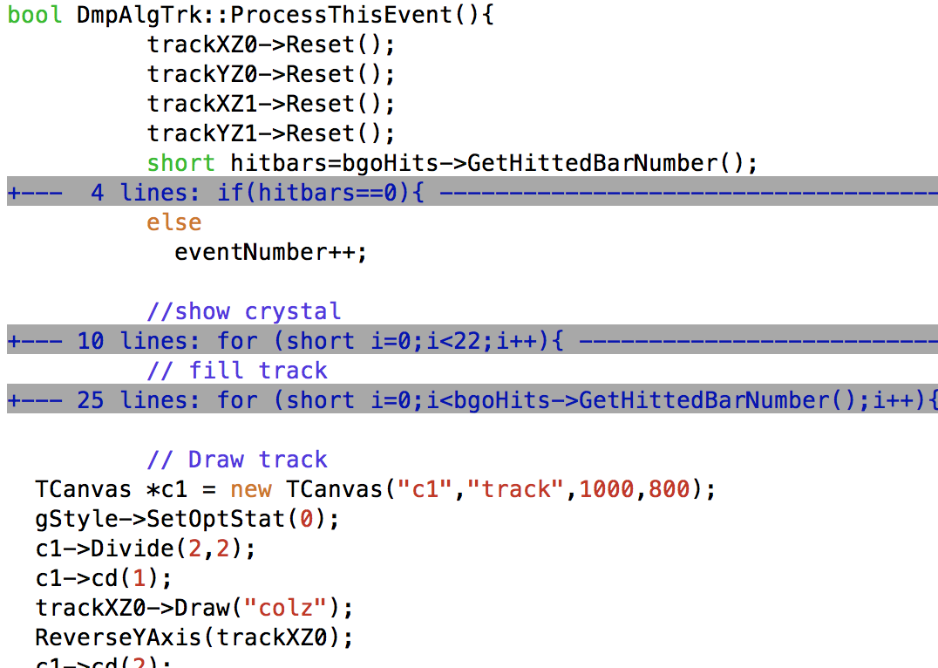
Algorithm
Example: draw track
source file, realize functions and
members that have been declared
In ProcessThisEvent(), get data in
input root file with the event class
Pointer.

Slide 39
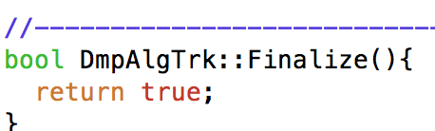
Algorithm
Example: draw track
source file, realize functions
and members that have been declared
Finialize(): in this function, you can save
what you want to save.
Release the memory you have applied.

Slide 40
Show Time
Show how to write an algorithm

Slide 41
Details
Algorithm manager
Service manager
Element manager

